Slide 1



Slide 2
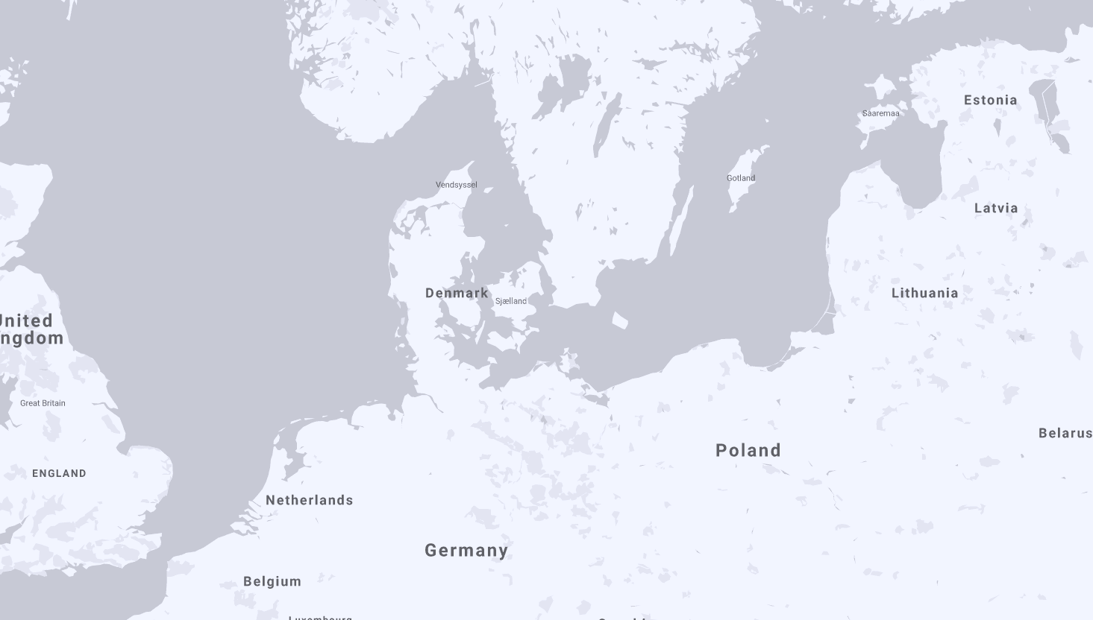


Our Data Centres
Data Centre Ballerup + Valby

Slide 3
2019
Transparency
Automated documentation
Automated release management
Automated access management
Stability
Hardware
Infrastructure
Platform

Slide 4


2020
Transparency
Further automation
Self-service
Visualising costs
Operations
IST Operations 2.0
More self-service = allows for a more dev-ops oriented work
More Cloud
Kubernetes – run anywhere
(Take a look at Operations Day!)
Bridge to public cloud vendors
Mainly AWS and Azure
We are taking the steps to be prepared for a hybrid cloud…
With abilities to use public cloud for Big Data or AI/ML operations for instance

